Slide 1
User Input Validating
Notes:
Xác nhận đầu vào người sử dụng

Slide 2
Overview
Overview of User Input Validation
Using Validation Controls
Page Validation
Notes:
Tổng quan về xác nhận đầu vào
Sử dụng điều khiển xác nhận
Xác nhận trang

Slide 3
Lesson: Overview of User Input Validation
What Is Input Validation?
Client-Side and Server-Side Validation
ASP.NET Validation Controls
Notes:
Tại sao phải xác nhận đầu vào

Slide 4
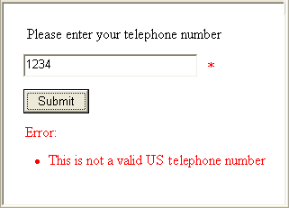
What Is Input Validation?
Verifies that a control value is correctly entered by the user
Blocks the processing of a page until all controls are valid
Avoids spoofing or the addition of malicious code
Notes:
Xác nhận việc kiểm soát giá trị do người dung nhập đã chính xác chưa.
Khối xử lý của trang kiểm tra cho đến khi tất các control đều có giá trị đúng
Tránh giả mạo và bổ sung các mã độc hại

Slide 5
Client-Side and Server-Side Validation
ASP.NET can create both client-side and server-side validation
Client-side validation
Dependent on browser version
Instant feedback
Reduces postback cycles
Server-side validation
Repeats all client-side validation
Can validate against stored data
User Enters Data
Error Message
Valid?
No
Client
Yes
Server
Valid?
No
Yes
Web Application Processed

Slide 6
ASP.NET Validation Controls
ASP.NET provides validation controls to:
Compare values
Compare to a custom formula
Compare to a range
Compare to a regular expression pattern
Require user input
Summarize the validation controls on a page
Notes:
So sánh với một giá trị

Slide 7
Lesson: Using Validation Controls
Adding Validation Controls to a Web Form
Positioning Validation Controls on a Web Form
Combining Validation Controls
Input Validation Controls
Using the RegularExpressionValidator Control
Demonstration: Using Validation Controls
Using the CustomValidator Control
Demonstration: Using the CustomValidator Control

Slide 8
Adding Validation Controls to a Web Form
Add a validation control
Select the input control to validate
Set validation properties
<asp:TextBox id="txtName" runat="server" />
<asp:Type_of_Validator
id="Validator_id"
runat="server" ControlToValidate="txtName"
ErrorMessage="Message_for_error_summary" Display="static|dynamic|none"
Text="Text_to_display_by_input_control">
</asp:Type_of_Validator>

Slide 9
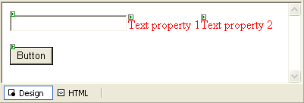
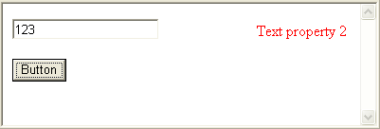
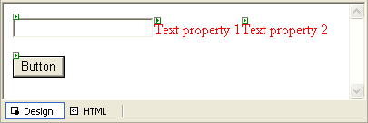
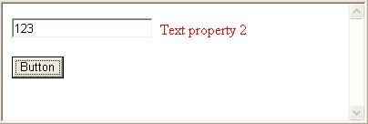
Positioning Validation Controls on a Web Form
Create error messages
Select display mode
Static
Dynamic

Slide 10
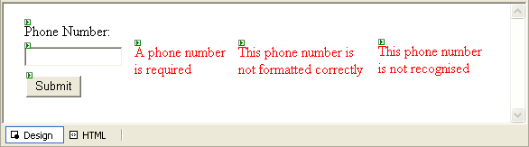
Combining Validation Controls
Can have multiple validation controls on a single input control
Only the RequiredFieldValidator checks empty controls

Slide 11
Input Validation Controls
RequiredFieldValidator
InitialValue
CompareValidator
ValueToCompare or ControlToCompare
Type
Operator
RangeValidator
MinimumValue
MaximumValue
Type

Slide 12
Using the RegularExpressionValidator Control
Used when input must conform to a pre-defined pattern
Visual Studio .NET includes patterns for:
Telephone numbers
Postal codes
E-mail addresses
<asp:RegularExpressionValidator …
ControlToValidate="US_PhoneNumber"… ValidationExpression="((\(\d{3}\) ?)|(\d{3}-))?\d{3}-\d{4} "
…>*</asp:RegularExpressionValidator >

Slide 13

Demonstration: Using Validation Controls
Create an ASP.NET Web Form with TextBox and Button controls
Add a RequiredFieldValidator control
Add a RangeValidator control
Add a RegularExpressionValidator control

Slide 14
Using the CustomValidator Control
Can validate on client-side, server-side, or both
ClientValidationFunction
OnServerValidate
Validate with:
Formula
Data
COM objects
Web Service
Code Example

Slide 15
Demonstration: Using the CustomValidator Control
Add a CustomValidator control
Write the server-side code
Write the client-side script
Test the result

Slide 16
Lesson: Page Validation
Using the Page.IsValid Property
Using the ValidationSummary Control
Demonstration: Using the Page.IsValid Property and the ValidationSummary Control

Slide 17
Using the Page.IsValid Property
Polls all validation controls
private void cmdSubmit_Click(object s, System.EventArgs e)
{ if (Page.IsValid)
{ Message.Text = "Page is Valid!";
// Perform database updates or other logic here
}
}

Slide 18
Using the ValidationSummary Control
Collects error messages from all validation controls on the page
Can display text and error messages
Use Text="*" to indicate the location of the error
<asp:ValidationSummary id="valSummary"
runat="server" HeaderText="These errors were found:" ShowSummary="True"
DisplayMode="List"/>

